Slide 1
Chapter 10
Data Flow Testing Slice Testing

Slide 2
Data Flow Testing
Often confused with "dataflow diagrams“.
Main concern: places in a program where data values are defined and used.
Static (compile time) and dynamic (execution time) versions.
Static: Define/Reference Anomalies on a
variable that
is defined but never used (referenced)
is used but never defined
is defined more than once
Starting point is a program, P, with program graph G(P), and the set V of variables in program P.
"Interesting" data flows are then tested as mini-functions.

Slide 3
Definitions
Node n ∈ G(P) is a defining node of the variable v ∈ V, written as DEF(v, n), iff the value of the variable v is defined at the statement fragment corresponding to node n.
Node n ∈ G(P) is a usage node of the variable v ∈ V, written as USE(v, n), iff the value of the variable v is used at the statement fragment corresponding to node n.
A usage node USE(v, n) is a predicate use (denoted as P-use) iff the statement n is a predicate statement; otherwise, USE(v, n) is a computation use (denoted C-use).

Slide 4
More Definitions
A definition-use path with respect to a variable v (denoted du-path) is a path in PATHS(P) such that for some v ∈ V, there are define and usage nodes DEF(v, m) and USE(v, n) such that m and n are the initial and final nodes of the path.
A definition-clear path with respect to a variable v (denoted dc-path) is a definition-use path in PATHS(P) with initial and final nodes DEF (v, m) and USE (v, n) such that no other node in the path is a defining node of v.

Slide 5
Example: first part of the Commission Program
Program Commission (INPUT,OUTPUT)
Dim locks, stocks, barrels As Integer
Dim lockPrice, stockPrice, barrelPrice As Real
Dim totalLocks, totalStocks, totalBarrels As Integer
Dim lockSales, stockSales, barrelSales As Real
Dim sales, commission As Real
lockPrice = 45.0
stockPrice = 30.0
barrelPrice = 25.0
totalLocks = 0
totalStocks = 0
totalBarrels = 0
Input(locks)
While NOT(locks = -1)
Input(stocks, barrels)
totalLocks = totalLocks + locks
totalStocks = totalStocks + stocks
totalBarrels = totalBarrels + barrels
Input(locks)
EndWhile
Output(“Locks sold: “, totalLocks)
Output(“Stocks sold: “, totalStocks)
Output(“Barrels sold: “, totalBarrels)

Slide 6
Rest of Commission Problem
Output(“Barrels sold: “, totalBarrels)
lockSales = lockPrice * totalLocks
stockSales = stockPrice * totalStocks
barrelSales = barrelPrice * totalBarrels
sales = lockSales + stockSales + barrelSales
Output(“Total sales: “, sales) 29. If (sales > 1800.0)
30. Then
31. commission = 0.10 * 1000.0
commission = commission + 0.15 * 800.0
commission = commission + 0.20 *(sales-1800.0)
Else If (sales > 1000.0)
Then
36. commission = 0.10 * 1000.0
commission = commission + 0.15 *(sales-1000.0)
Else
commission = 0.10 * sales
EndIf
EndIf
Output(“Commission is $”, commission)
End Commission

Slide 7
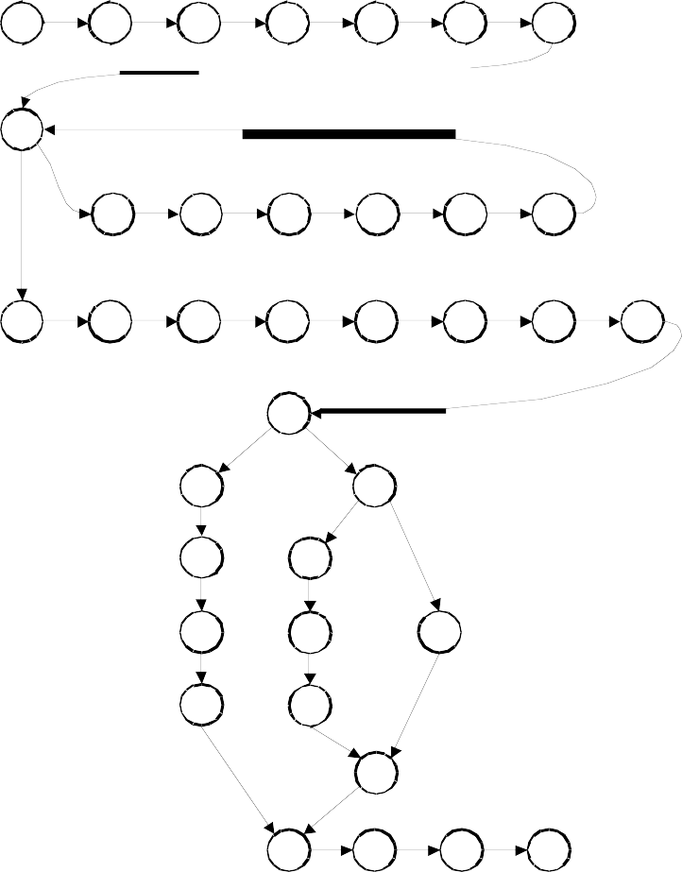
Program Graph of Commission Problem
7
8
9
10
11
12
13
14
15
16
17
18
19
20
21
22
23
24
25
26
27
28
29
30
34
31
35
32
36
38
33
37
39
40
41
42
43

Slide 8
Define/Use Test Cases
Technique: for a particular variable,
find all its definition and usage nodes, then
find the du-paths and dc-paths among these.
for each path, devise a "suitable" (functional?) set of test cases.
Note: du-paths and dc-paths have both static and dynamic interpretations
Static: just as seen in the source code
Dynamic: must consider execution-time flow (particularly for loops)
Definition clear paths are easier to test
No need to check each definition node, as is necessary for du-paths

Slide 9
Define and Use Nodes
Variable | Defined at Node | Used at Node
locks | 13, 19 | 14, 16
stocks | 15 | 17
barrels | 15 | 18
totalLocks | 10, 16 | 16, 21, 24
totalStocks | 11, 17 | 17, 22, 25
totalBarrels | 12, 18 | 18, 23, 26

Slide 10
Example (continued)
Input(locks)
While NOT(locks = -1)
Input(stocks, barrels)
totalLocks = totalLocks + locks
totalStocks = totalStocks + stocks
totalBarrels = totalBarrels + barrels
Input(locks)
EndWhile We have
•
•
•
•
DEF (locks, 13), DEF (locks, 19) USE (locks, 14), a predicate use USE (locks, 16). A computation use
du-paths for locks are the node sequences <13, 14> (a dc-path),
<13, 14, 15, 16>, <19, 20, 14 >, < 19, 20, 14 , 15, 16>
Is <13, 14, 15, 16> definition clear?
Is < 19, 20, 14, 15, 16> definition clear? What about repetitions?
•
•

Slide 11
Coverage Metrics Based on du-paths
In the following definitions, T is a set of paths in the program graph G(P) of a program P, with the set V of variables.
The set T satisfies the All-Defs criterion for the program P iff for every variable v ∈ V, T contains definition-clear paths from every defining node of v to a use of v.
The set T satisfies the All-Uses criterion for the program P iff for every variable v ∈ V, T contains definition-clear paths from every defining node of v to every use of v, and to the successor node of each USE(v, n).

Slide 12
Coverage Metrics Based on du-paths
(continued)
The set T satisfies the All-P-Uses/Some C-Uses criterion for the program P iff for every variable v ∈ V, T contains definition-clear paths from every defining node of v to every predicate use of v; if a definition of v has no P-uses, a definition-clear path leads to at least one computation use.

Slide 13
Coverage Metrics Based on du-paths
(continued)
The set T satisfies the All-C-Uses/Some P-Uses criterion for the program P iff for every variable v ∈ V, T contains definition-clear paths from every defining node of v to every computation use of v; if a definition of v has no C-uses, a definition-clear path leads to at least one predicate use.

Slide 14
Coverage Metrics Based on du-paths
(concluded)
The set T satisfies the All-du-paths criterion for the program P iff for every variable v ∈ V, T contains definition-clear paths from every defining node of v to every use of v and to the successor node of each USE(v, n), and that these paths are either single-loop traversals or cycle-free.

Slide 15
Rapps-Weyuker Coverage Subsumption
All Paths
All DU Paths All Uses
All C Uses Some P Uses
All P Uses Some C Uses
All Defs
All P Uses
All Edges
All Nodes
S. Rapps and E. J. Weyuker
"Selecting Software Test Data Using Data Flow Information"
IEEE Transactions of Software Engineerin,gvol 11 no 4 IEEE Computer Society Press, Washington, D. C. , April 1985, pp 367 - 375.

Slide 16
Exercise: Where does the “All definition-clear paths” coverage metric fit in the Rapps-Weyuker lattice?

Slide 17
Data Flow Testing Strategies
Data flow testing is indicated in
Computation-intensive applications
“long” programs
Programs with many variables
A definition-clear du-path represents a small function that can be tested by itself.
If a du-path is not definition-clear, it should be tested for each defining node.

Slide 18
Slice Testing
Often confused with "module execution paths"
Main concern: portions of a program that "contribute" to the value of a variable at some point in the program.
Nice analogy with history -- a way to separate a complex system into "disjoint" components that interact:
European history
North American history
Orient history
A dynamic construct.

Slide 19
Slice Testing Definitions
Starting point is a program, P, with program graph G(P), and the set V of variables in program P. Nodes in the program graph are numbered and correspond to statement fragments.
Definition: The slice on the variable set V at statement fragment n, written S(V, n), is the set of node numbers of all statement fragments in P prior to n that contribute to the values of variables in V at statement fragment n.
This is actually a “backward slice”.
Exercise: define a “forward slice”.

Slide 20
Fine Points
"prior to" is the dynamic part of the definition.
"contribute" is best understood by extending the Define and Use concepts:
P-use: used in a predicate (decision)
C-use: used in computation
O-use: used for output
L-use: used for location (pointers, subscripts)
I-use: iteration (internal counters, loop indices)
I-def: defined by input
A-def: defined by assignment
usually, the set V of variables consists of just one element.
can choose to define a slice as a compilable set of statement fragments -- this extends the meaning of "contribute"
because slices are sets, we can develop a lattice based on the subset relationship.

Slide 21
In the program fragment
Input(locks)
While NOT(locks = -1)
Input(stocks, barrels)
totalLocks = totalLocks + locks
totalStocks = totalStocks + stocks
totalBarrels = totalBarrels + barrels
Input(locks) 20.EndWhile
There are these slices on locks (notice that statements 15, 17, and 18 do not appear):
S1: S(locks, 13) = {13}
S2: S(locks, 14) = {13, 14, 19, 20}
S3: S(locks, 16) = {13, 14, 19, 20}
S4: S(locks, 19) = {19}

Slide 22
Lattice of Slices
Because a slice is a set of statement fragment numbers, we can find slices that are subsets of other slices.
This allows us to “work backwards” from points in a program, presumably where a fault is suspected.
The statements leading to the value of commission when it is output are an excellent example of this pattern.
Some researchers propose that this is the way good programmers think when they debug code.

Slide 23
Example Lattice of Slices
^{S}34
^{S}35
^{S}37
^{S}36
^{S}38
^{S}39
S34: S(commission, 41) = {41}
^{S}40
S35: S(commission, 42) = {41, 42}
S36: S(commission, 43) = {3, 4, 5, 19, 20, 21, 22, 23, 24, 25, 26, 27, 28, 30, 36, 41, 42, 43}
S37: S(commission, 47) = {47}
S38: S(commission, 48) = {3, 4, 5, 19, 20, 21, 22, 23, 24, 25, 26, 27, 28, 29, 30, 36, 47, 48}
S39: S(commission, 50) = {3, 4, 5, 19, 20, 21, 22, 23, 24, 25, 26, 27, 28, 29, 30, 36, 50}
S40: S(commission, 51) = {3, 4, 5, 19, 20, 21, 22, 23, 24, 25, 26, 27, 28, 29, 30, 36,
41, 42, 43, 47, 48, 50}

Slide 24
Diagnostic Testing with Slices
Relative complements of slices yield a "diagnostic" capability. The relative complement of a set B with respect to another set A is the set of all elements of A that are not elements of B. It is denoted as A - B.
Consider the relative complement set S(commission, 48) - S(sales, 35):
– S(commission, 48) = {3, 4, 5,36,18,19, 20, 23, 24, 25, 26, 27, 34, 38,
39, 40, 44,45,47}
– S(sales, 35) = {3, 4, 5, 36, 18, 19, 20, 23, 24, 25, 26, 27}
– S(commission, 48) - S(sales, 35) = {34, 38, 39, 40, 44,45,47}
If there is a problem with commission at line 48, we can divide the program into two parts, the computation of sales at line 34, and the computation of commission between lines 35 and 48. If sales is OK at line 34, the problem must lie in the relative complement; if not, the problem may be in either portion.

Slide 25
Programming with Slices
One researcher suggests the possibility of “slice splicing”:
Code a slice, compile and test it.
Code another slide, compile and test it, then splice the two slices.
Continue until the whole program is complete.
Exercise: in what ways is slice splicing distinct from agile (bottom up) programming?

Slide 26
Exercise/Discussion: When should testing stop?
when you run out of time?
when continued testing causes no new failures?
when continued testing reveals no new faults?
when you can't think of any new test cases?
when you reach a point of diminishing returns?
when mandated coverage has been attained?
when all faults have been removed?

